Slide 1


SOFTWARE Design & Analysis (Week-10)
Usama Musharaf
MS-CS (Software Engineering)
Lecturer (Department of Computer Science)
FAST-NUCES Peshawar

Slide 2
Agenda of Week # 10
Coding for ATM Case Study (see week-5 lectures for design details)

Slide 3
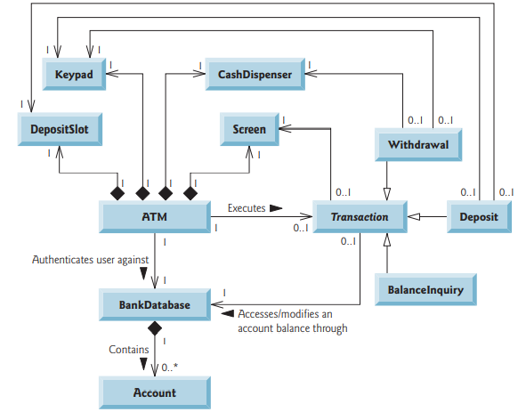

Slide 4
Lets Code!

Slide 5
HAVE A GOOD DAY!

